Slide 1


CALL FOR CODE 2020
Ministry /Organization name : IBM ( International Bussiness Machines )
Team name : AlphaMARS
Team Members : Ritul Kumar Sharma , Ankit Sharma , Shubham
Sinha
Problem Statement:
Predicting the Energy output of Wind turbines based on weather Condition.

Slide 2
SOLUTION
We all know that it looks very simple but it is more complex and challenging than we think. Accurate and reliable wind speed forecasts are a significant challenge due to its high rates of change, highly nonlinear behavior with no typical patterns, and dependency on elevation, terrain, atmospheric pressure, and temperature, which results in large uncertainties of wind speeds. This makes it difficult for any machine learning model to figure out a pattern and give an accurate prediction. We made it easy to interpret this problem as time series forecasting problem because the wind follows a particular pattern for a certain period for like a day, month or year. Long Short-Term Memory (LSTM) machine learning model
TECHNOLOGY SIMPLIFICATION
Project Requirements: Python, IBM Cloud, IBM Watson;
Functional Requirements: IBM cloud;
Technical Requirements: ML,WATSON STUDIO,PYTHON;
Software Requirements: Watson assistant, PYTHON;

Slide 3
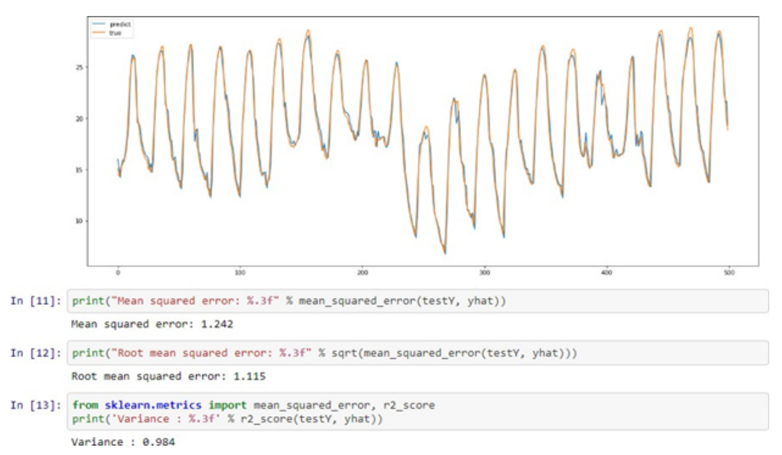
Experimental Investigation:-
Experiment 1: Six years hourly data was divided into 70-30 train test batch for this experiment. That means 4 years of data was used to predict 2 years of wind power generation. Good result with root mean square error(RMSE) 1.242 and Variance 0.984 was observed for this experiment.

Slide 4
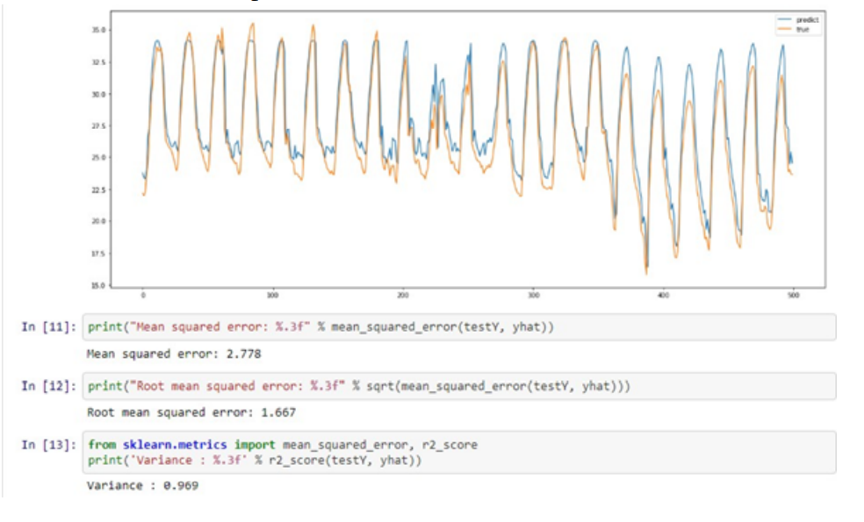
Experiment 2:
Six years hourly data was divided into 60-40 train test batch for this experiment. That means 3 years of data was used to predict 3 years of wind power generation. Good result with RMSE of 1.667 and Variance 0.969 was observed for this experiment.

Slide 5
ADVANTAGES
Once the wind turbine is built the energy it produces does not cause green house gases or other pollutants.
Wind turbines have a role to play in both the developed and third world.
Remote areas that are not connected to the power grid can use wind turbines to produce their own electricity.
Many people find wind farms an interesting feature of the landscape.
Applicatons:
As we all know Renewable energy is the future of energy and wind mills is one that would be mostly used as a renewable source of energy because it takes less space as compared to others, more efficient and doesn't harm the environment in any way, that's why this system will be high in demand for cost reduction in construction and maintenance when constructing it according to the whether of the given place and will also help in increasing the efficiency of the energy output
THANKS FOR YOUR TIME

Slide 6
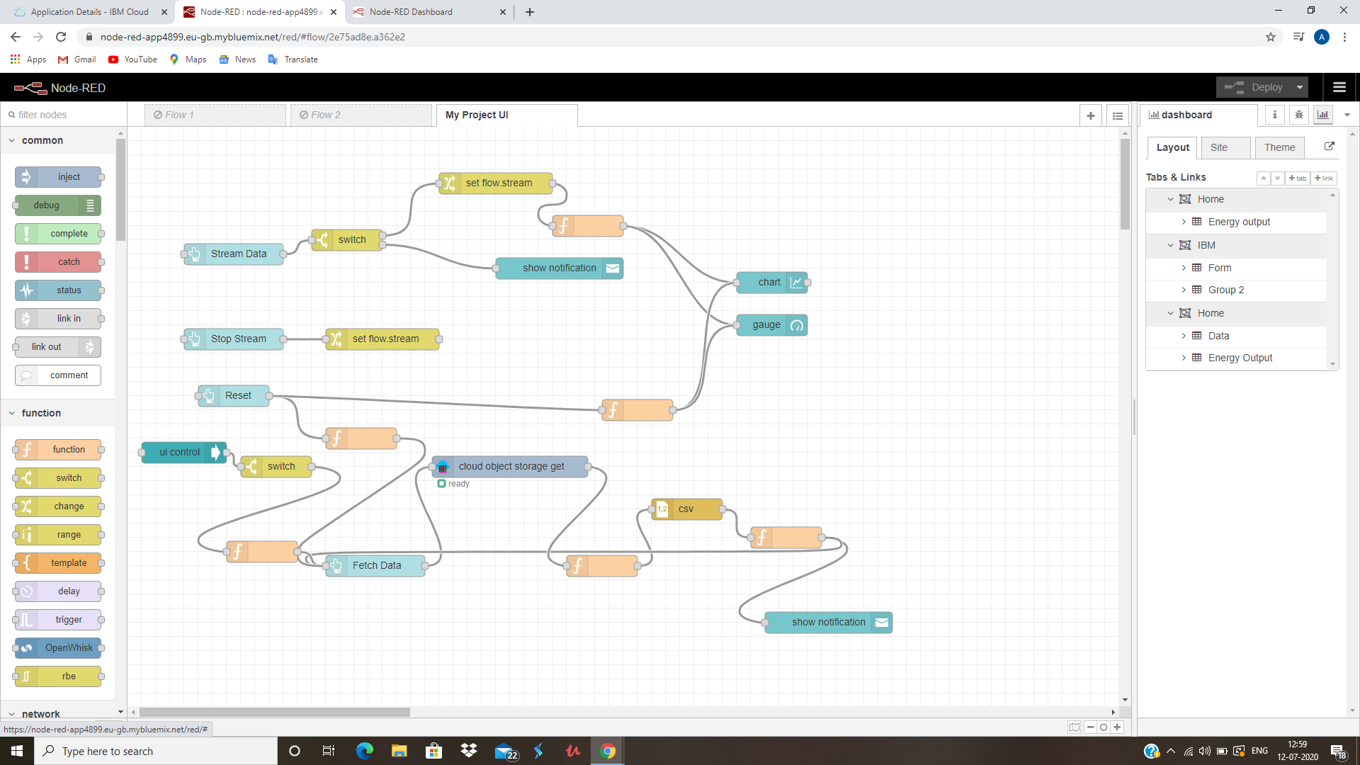
NODERED FLOW:-

Slide 7
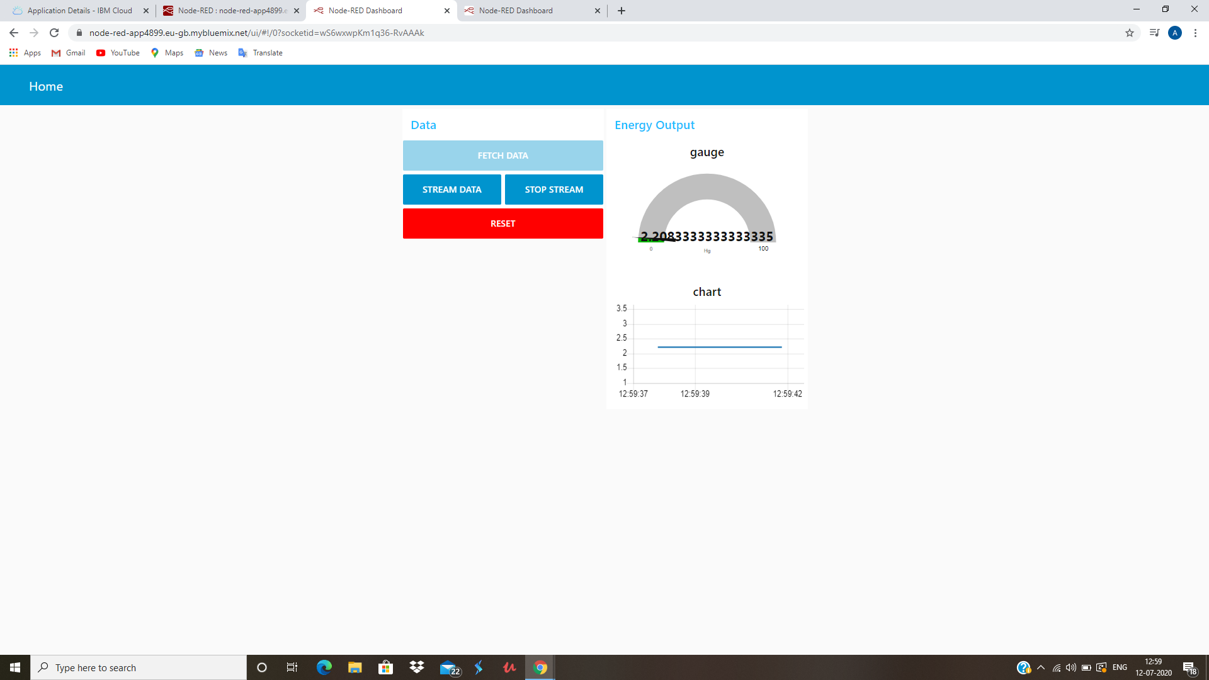
PROJECT OUTPUT:-

